Slide 1

Information Requirements for Integrating Spatially Discrete, Feature-Based Earth Observations
Jeffery S. Horsburgh
Anthony Aufdenkampe, Kerstin Lehnert, Emilio Mayorga, Leslie Hsu, Lulin Song, Ilya Zaslavsky, David Valentine
Support:
1224638

Slide 2






Challenge
Information models of current geoscience cyberinfrastructures:
Represent common information elements in inconsistent ways (e.g., people, units, measured variables, etc.)
Lack extensibility required for supporting additional data types

Slide 3
Given data sharing requirements from funding agencies:
What information must accompany observational data for them to be archivable and discoverable within a publication system as well as interpretable once retrieved from such a system for analysis and (re)use?

Slide 4
Overarching Goals
Create an information model (ODM2) that is integrative and extensible
Accommodating a wide range of observational data
Aimed at achieving interoperability across multiple disciplines and systems that support publication of earth observations
Allow a diverse range of geoscience observations to be consistently managed, shared, discovered, accessed, and interpreted

Slide 5
Common Semantics for Earth Observations
Observations
Information Model
Storage
Schema
Transfer
Schema
Metadata Catalog
Schema
CUAHSI
HIS
EarthChem
CZOData
IOOS
Domain Cyberinfrastructures

Slide 6
Design Process
Series of community design and prototyping workshops over the past 2 years
Scientists from multiple domains
Cyberinfrastructure experts representing multiple domains/systems
Extract requirements, data use cases, test preliminary designs

Slide 7
Requirement: Describe Observed Feature(s)

Slide 8
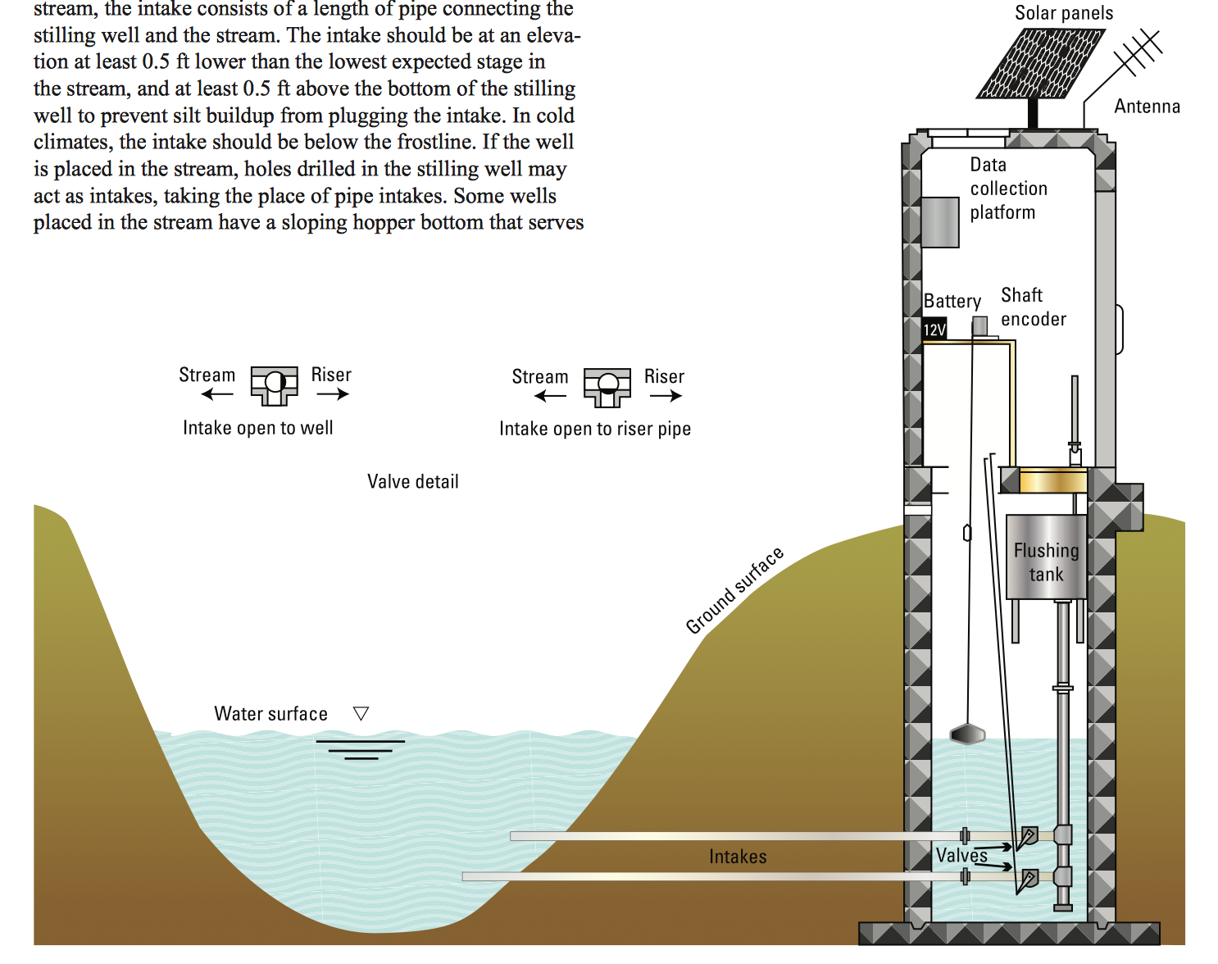
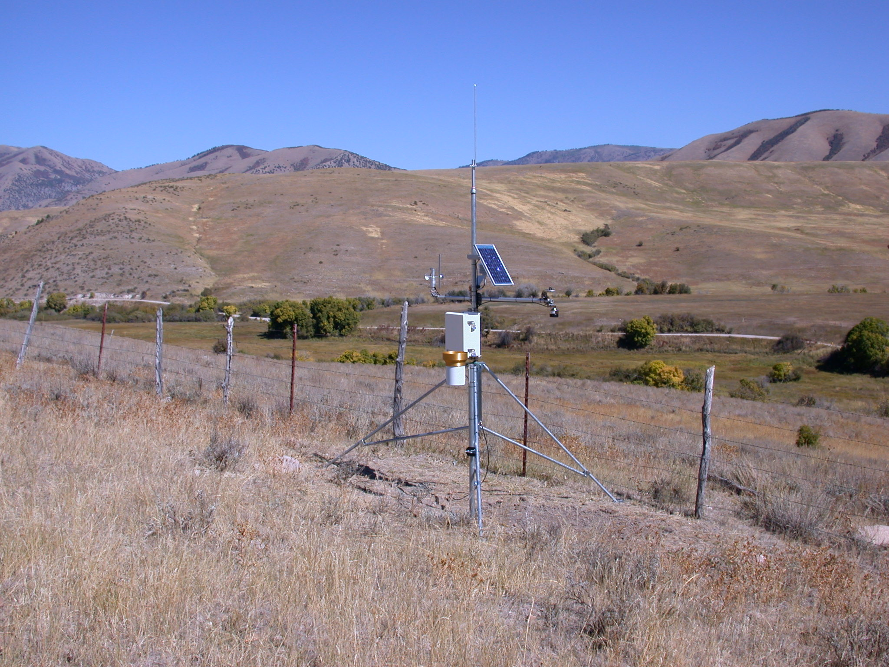
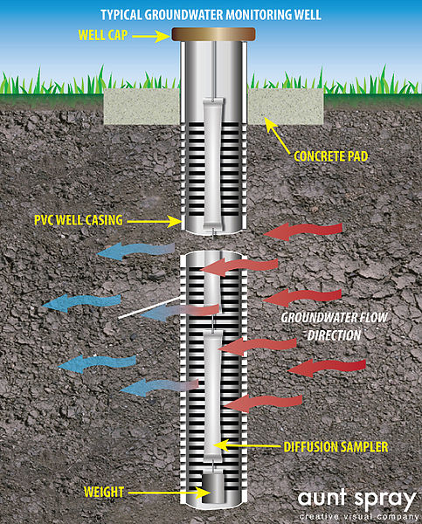
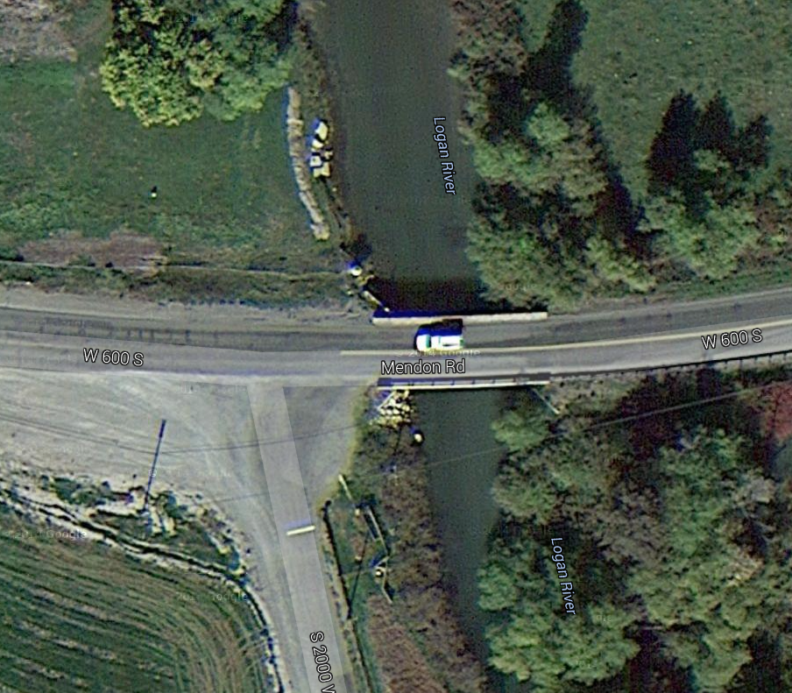

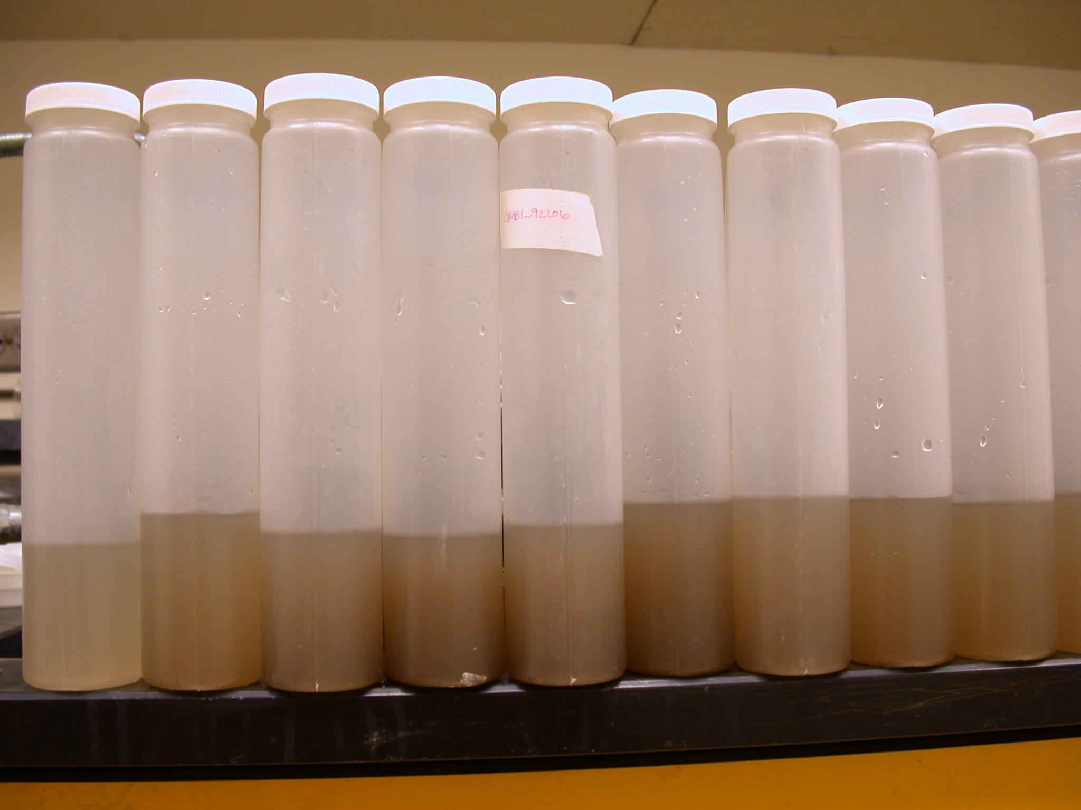
Sampling Features
Stream Gage
Weather Station
Observation
Well
http://commons.wikimedia.org/wiki/File:Monitoring_Well_Diagram.jpg
Source: http://pubs.usgs.gov/tm/tm3-a7/
Monitoring Site:
A location established for making observations
Represented as a point
May have a geospatial footprint that is not a point
Specimens

Slide 9
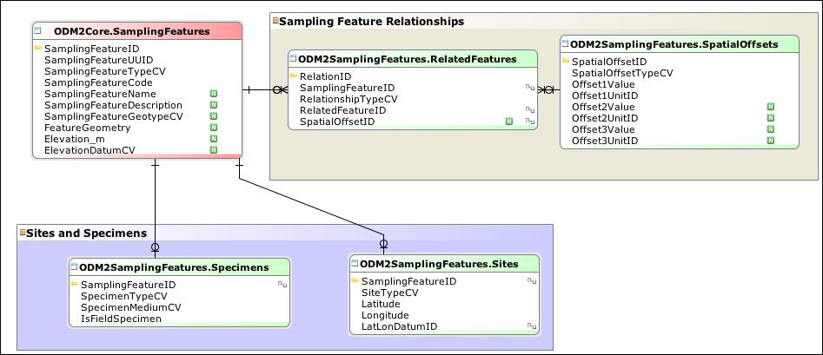
Sampling Features in ODM2
From OGC’S Observations & Measurements:
Sampling Feature = the entities on which or at which observations are made

Slide 10
Requirement: Support Diverse Data Types

Slide 11
Time Series Result
Space = Fixed
Time = Controlled
Variable = Measured
Z
Y
X
Date | Temperature (Deg. C)
12/1/2014 8:00 AM | 10.1
12/1/2014 9:00 AM | 10.2
12/1/2014 10:00 AM | 10.4
12/1/2014 11:00 AM | 10.8
. . . | . . .
Fixed Sensor Position
Time Series Result

Slide 12
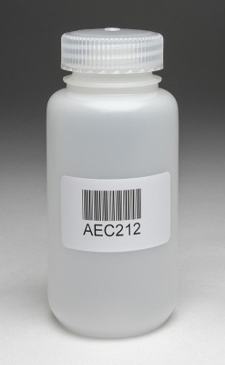
Measurement Result
Space = Fixed
Time = Fixed
Variable = Measured
Z
Y
X
Total phosphorus = 0.04 mg/L
Total suspended solids = 10 mg/L
Fixed Sampling Position and Time
Specimen

Slide 13
Section Result
Space = Controlled
Time = Fixed or Controlled
Variable = Measured
Z
Y
Velocity = 2.5 ft/s
X
Discrete point measurements within a section

Slide 14
Transect Result
Space = Controlled
Time = Fixed or Controlled
Variable = Measured
pH = 7.0
Z
pH = 7.3
Y
X
pH = 7.5
pH = 7.2
Measurements along a transect

Slide 15
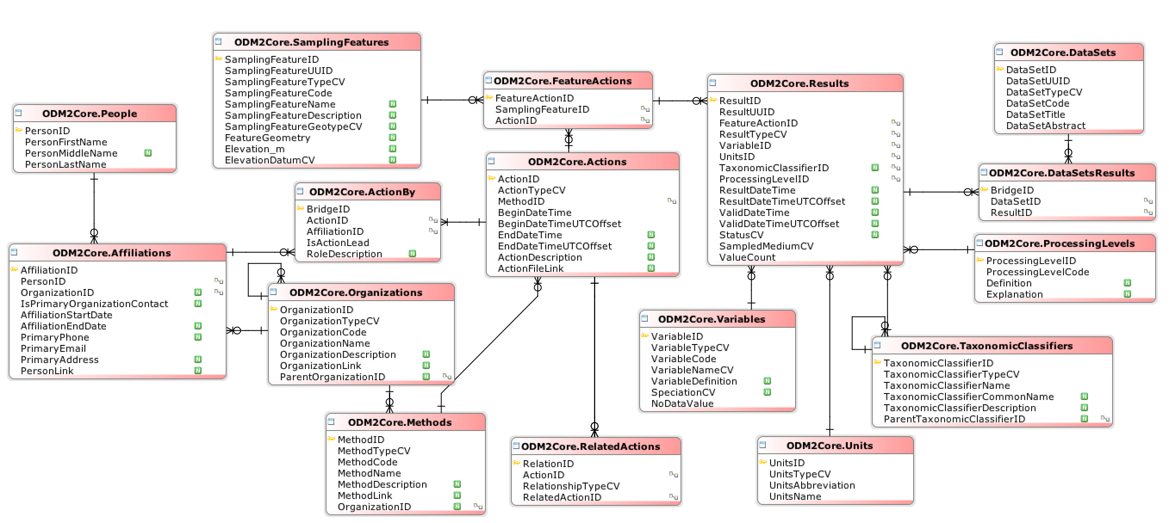
ODM2 Core Schema + Results
Time Series
Measurement
Transect
. . .
People and organizations
Actions
Results
Measured variables
Units
Processing levels
Space
Time
Measured Values

Slide 16
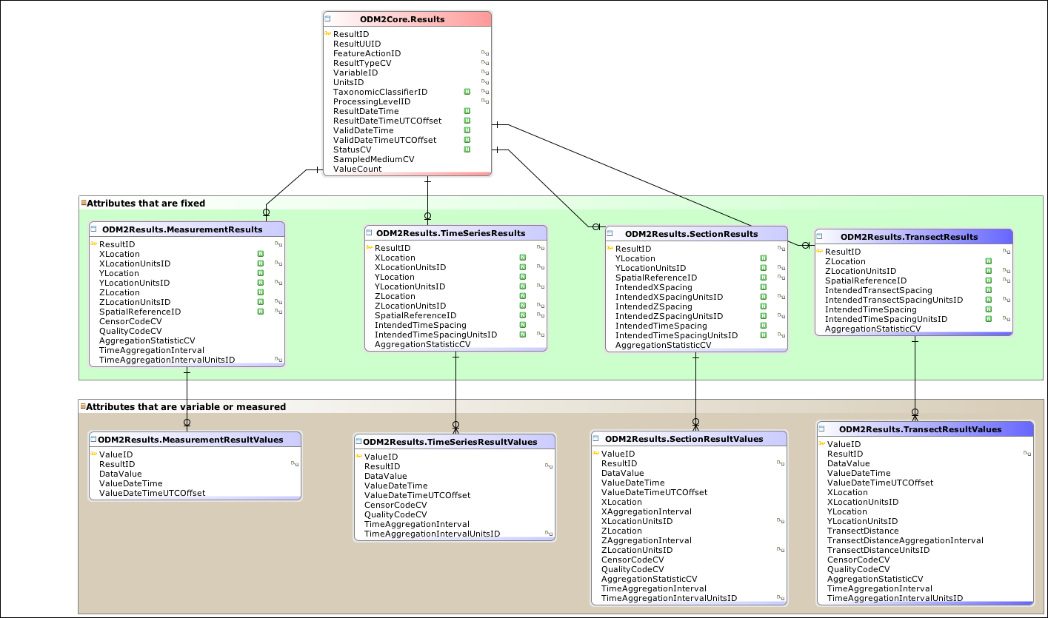
ODM2 Results
Attributes that are fixed
Attributes that are variable or measured
Measurement
Result
Time Series
Result
Section
Result
Transect
Result

Slide 17
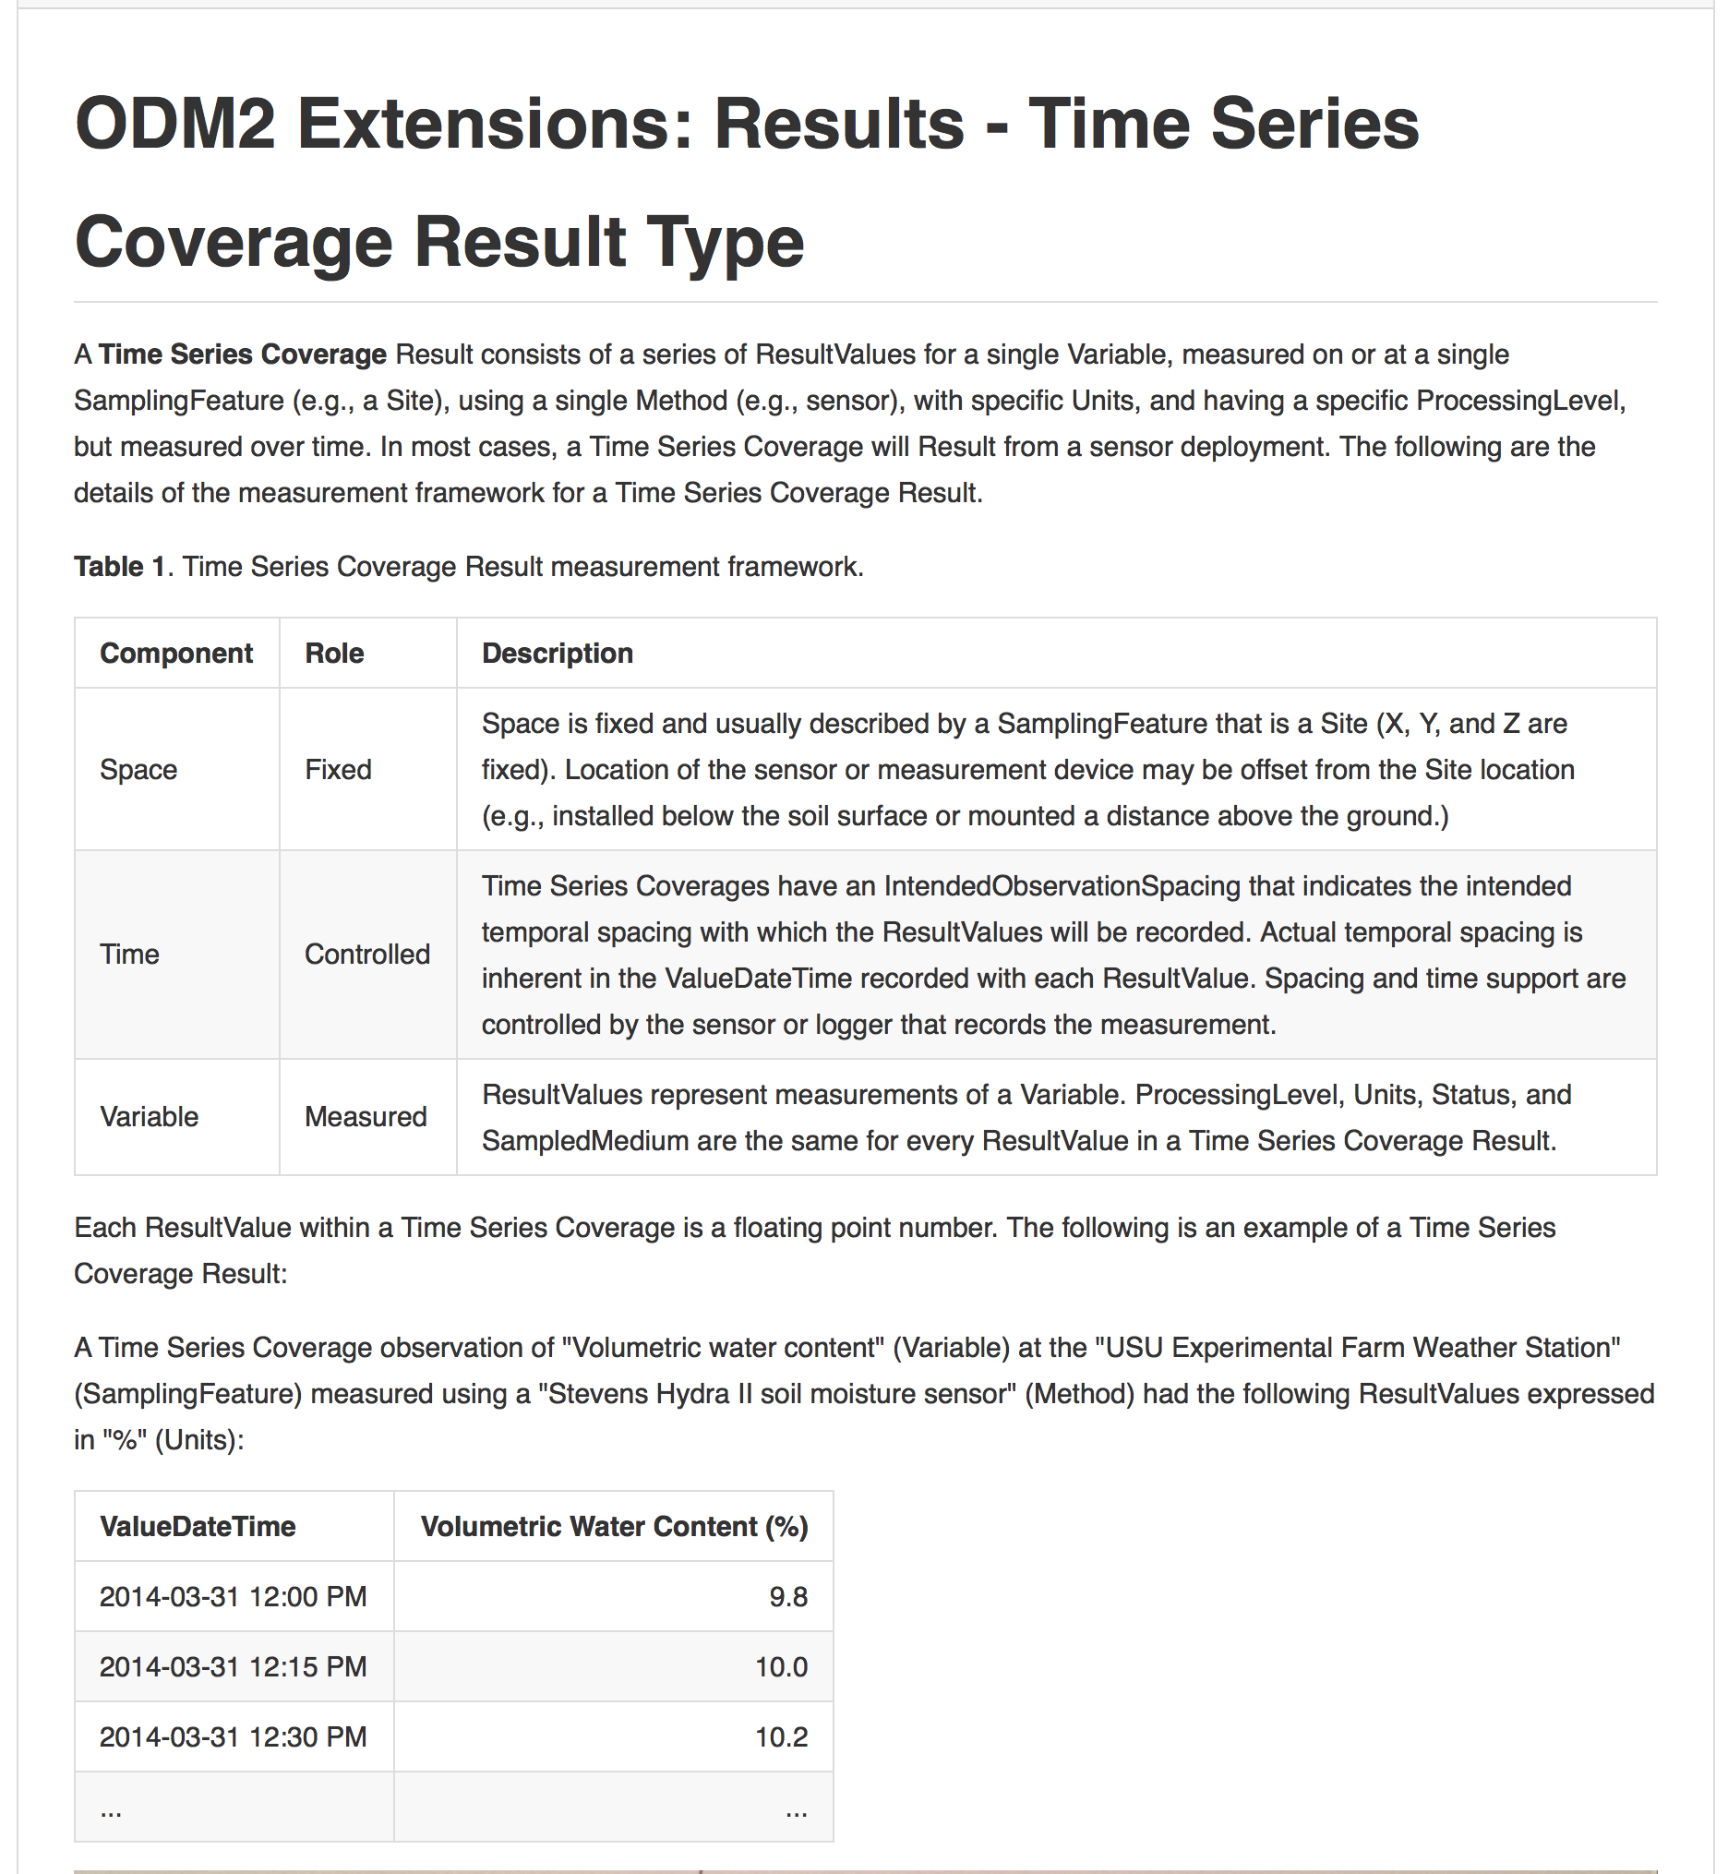
ODM2 Results: Measurement Frameworks
Documents how space, time, and measured variables are handled

Slide 18
Requirement: Support Observation Provenance

Slide 19
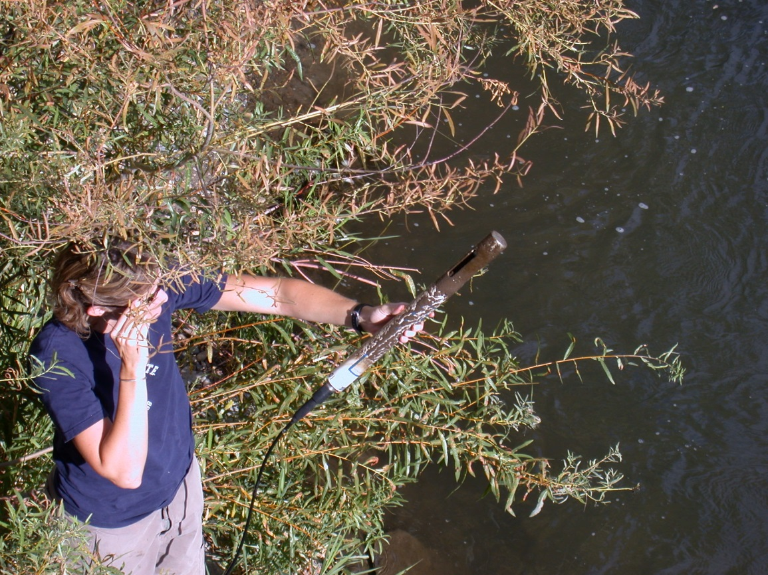
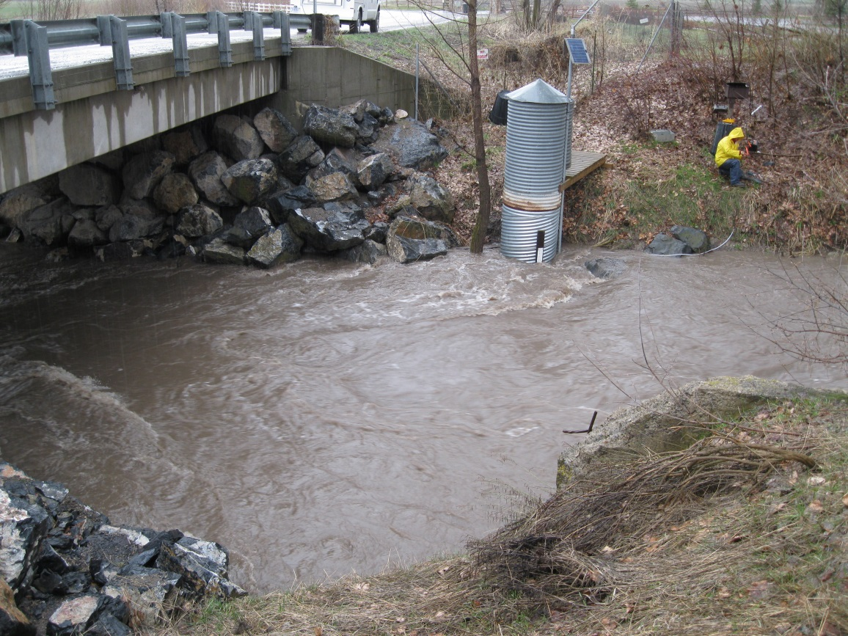
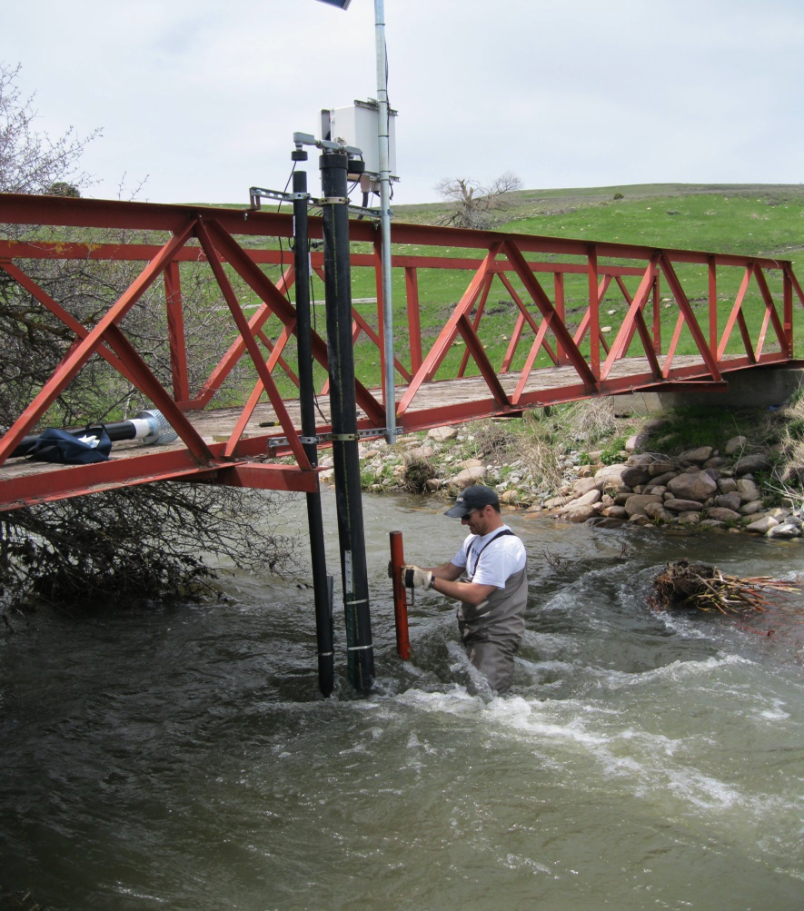
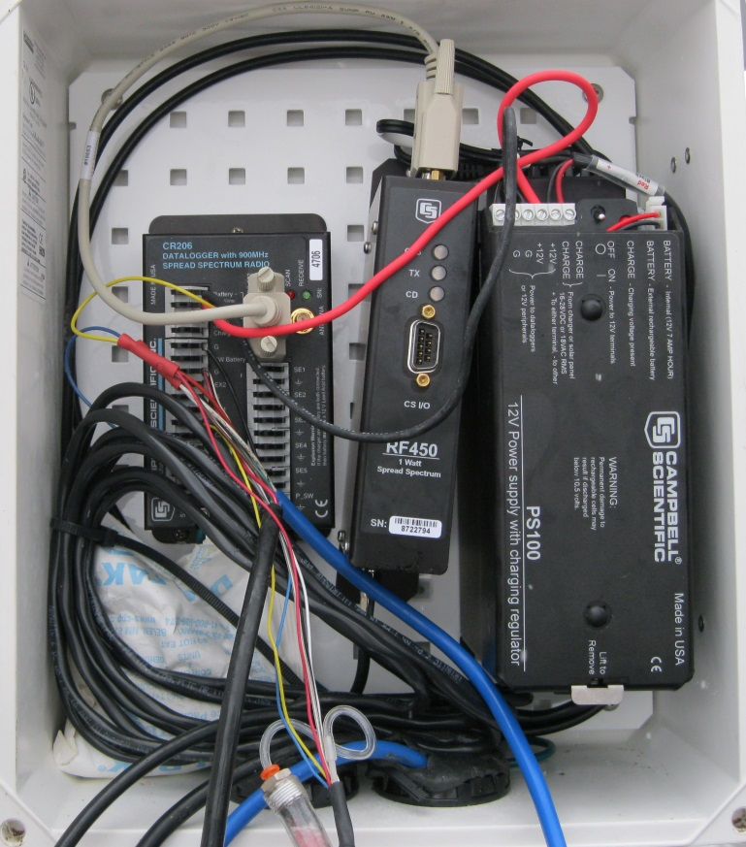
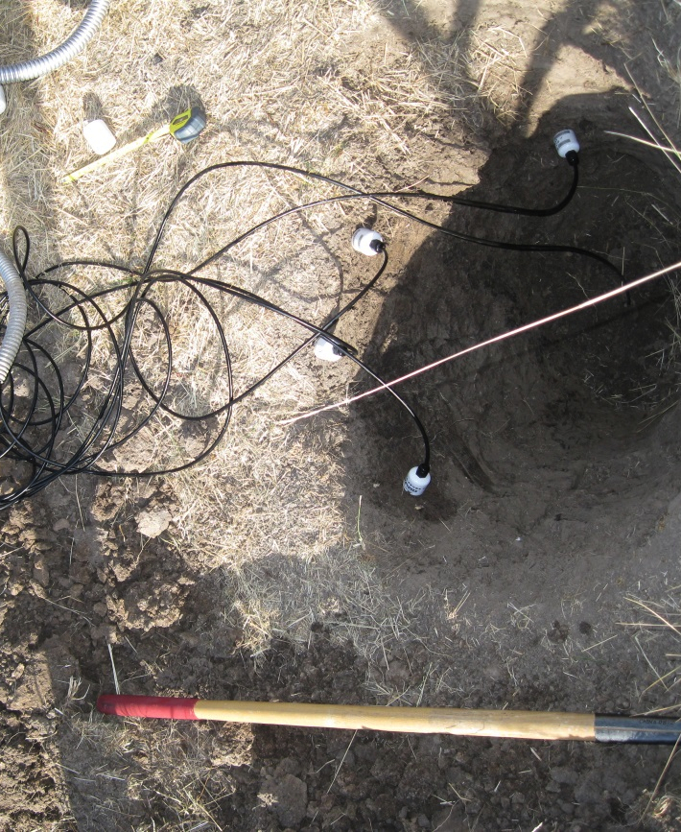
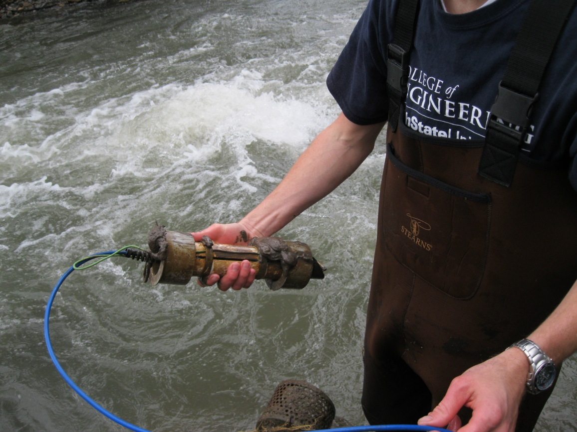
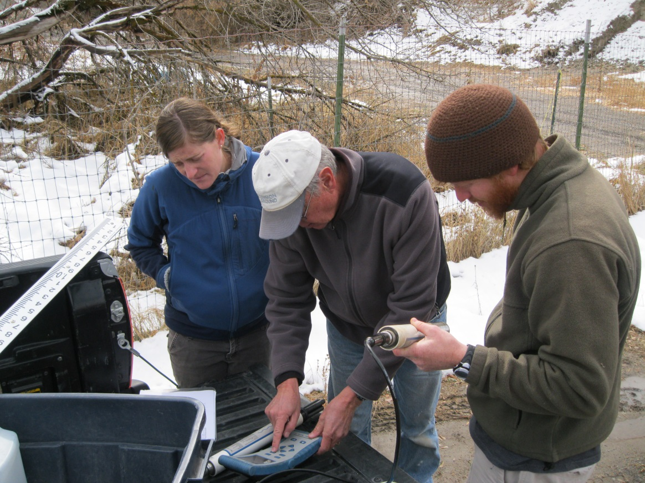
Monitoring Equipment Management
Which sensors were deployed at this site? Who installed them?
When was the last time we cleaned this sonde?
What were the field conditions of our discharge measurement?
Who programmed this datalogger?
Has this turbidity sensor been serviced at the factory?
What is this dissolved oxygen sensor’s calibration history?
How long has that battery been deployed?
Which soil moisture sensor is buried at 40 cm?
Notes:
A step that is often overlooked in sensor networks is management of the inventory of data collection equipment (. This includes information about which equipment has been deployed at each monitoring site, but also includes a record of field activities and service events, including sensor calibrations, as well as routine factory service for sensors and dataloggers. This information is typically recorded in field notes or files, but is rarely linked directly to the data being collected. Yet, there are many scenarios where performing quality control of the data or even eventual interpretation of the data in analyses require consulting the record of field activities.

Slide 20
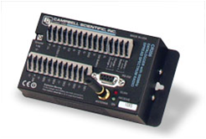
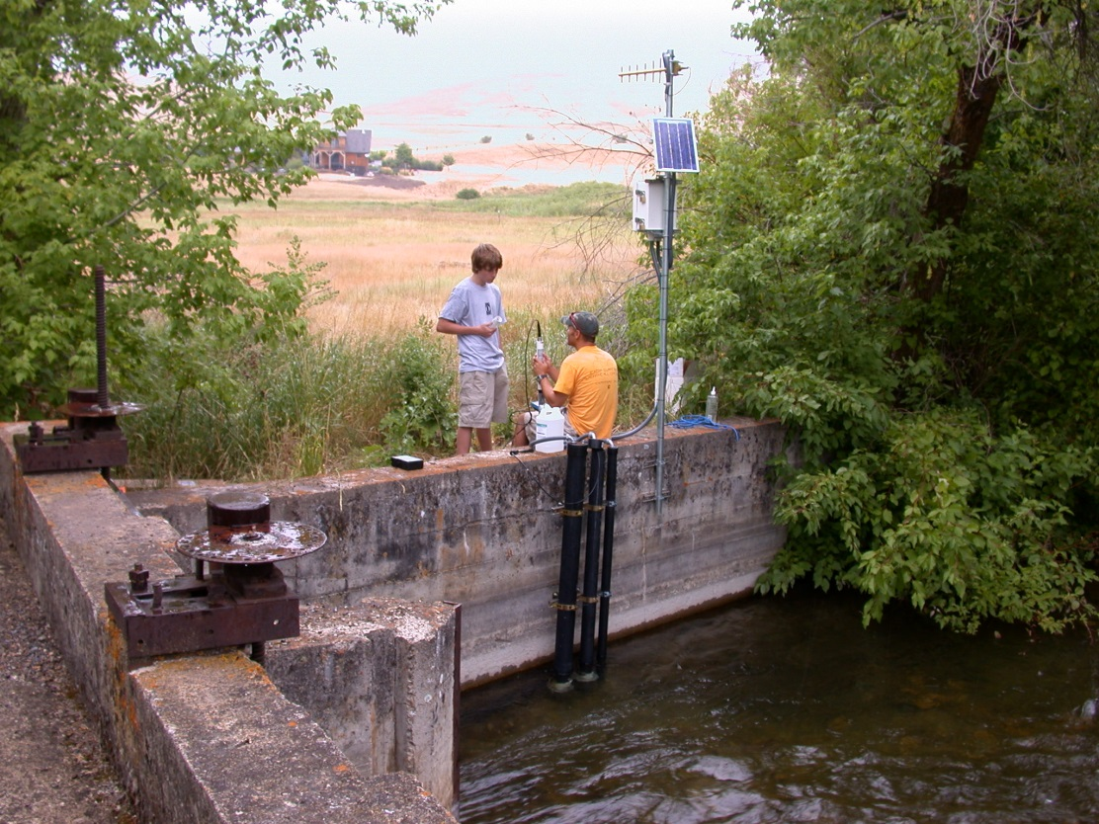
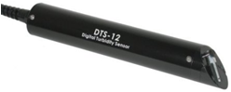
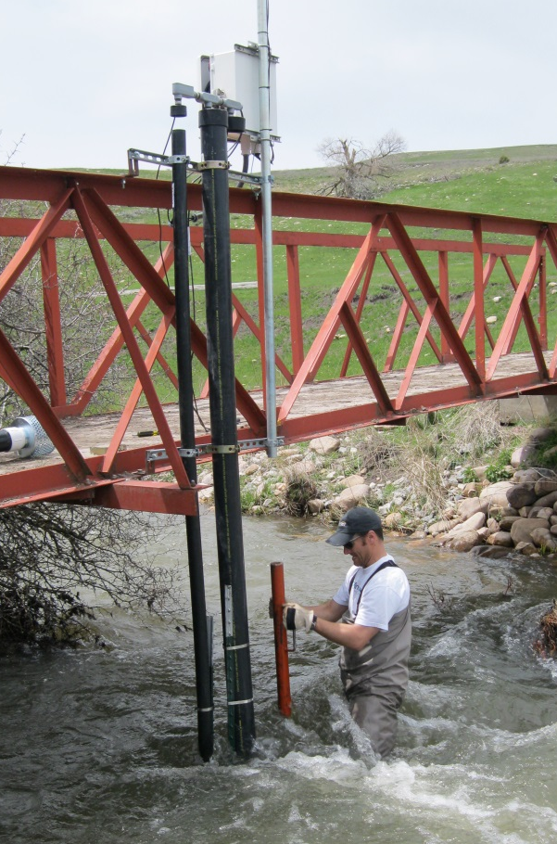
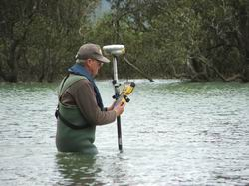
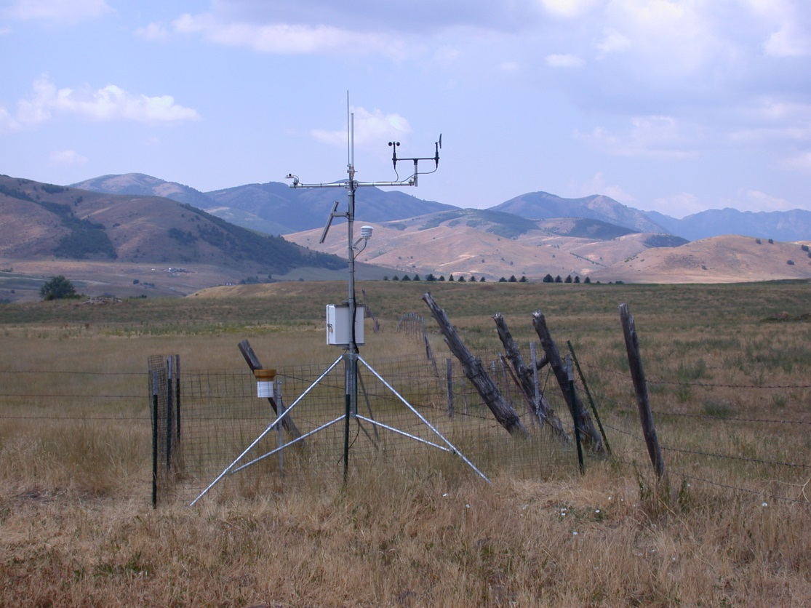
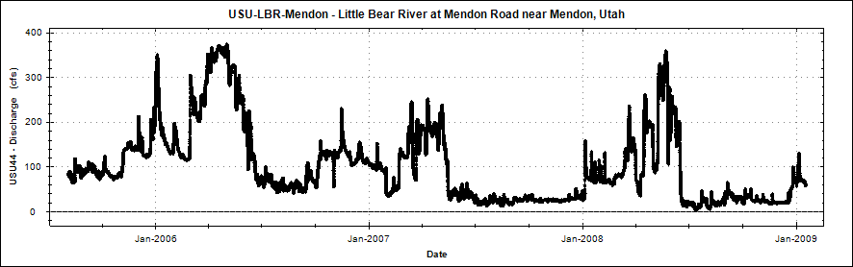
Sensor Workflows
Calibrations
Equipment
Model
Serial number
Owner
Vendor
Manufacturer
Service history
Method
Standard
Site visits
Field activities
Deployments
Location
Date
People
Conditions
Time Series Observations
Activity type
Description
Date
Deployment type
Description
Dates
Offsets

Slide 21
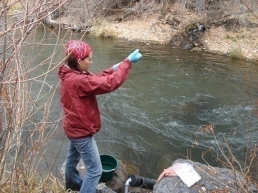


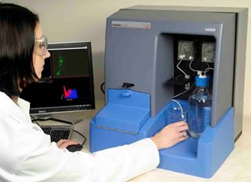
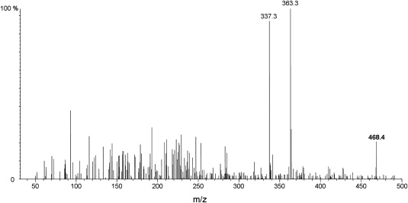
Sampling Workflows
Sample collection
Sample splitting
Sample processing
Sample analysis
Sample type
Location / sampled feature
Collection method
Date
People
Preservation
Identifiers
Sampled medium
Analytical method
Instrument
People
Date
Sample hierarchy
Parent/child relationships
Preparation method
Processing method
People
Sample analysis actions result in observations

Slide 22
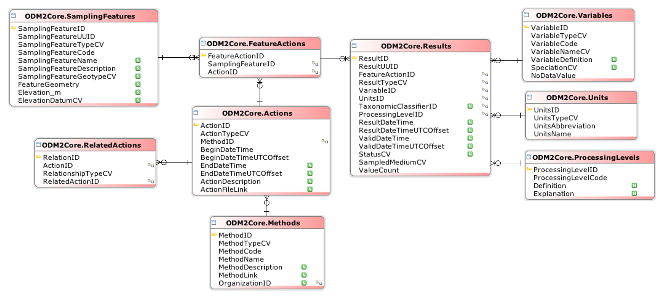
Actions and Results
An Action is performed on or at a SamplingFeature using a Method
Actions can be related to each other
Some Actions produce Results
Results have a Variable, Units, and a ProcessingLevel

Slide 23
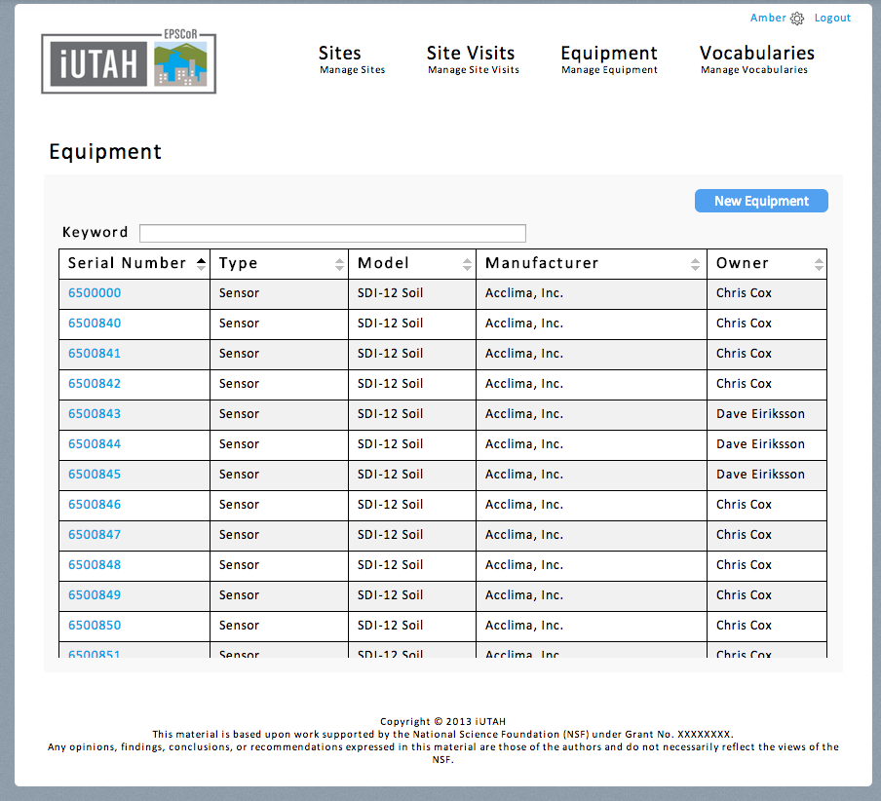
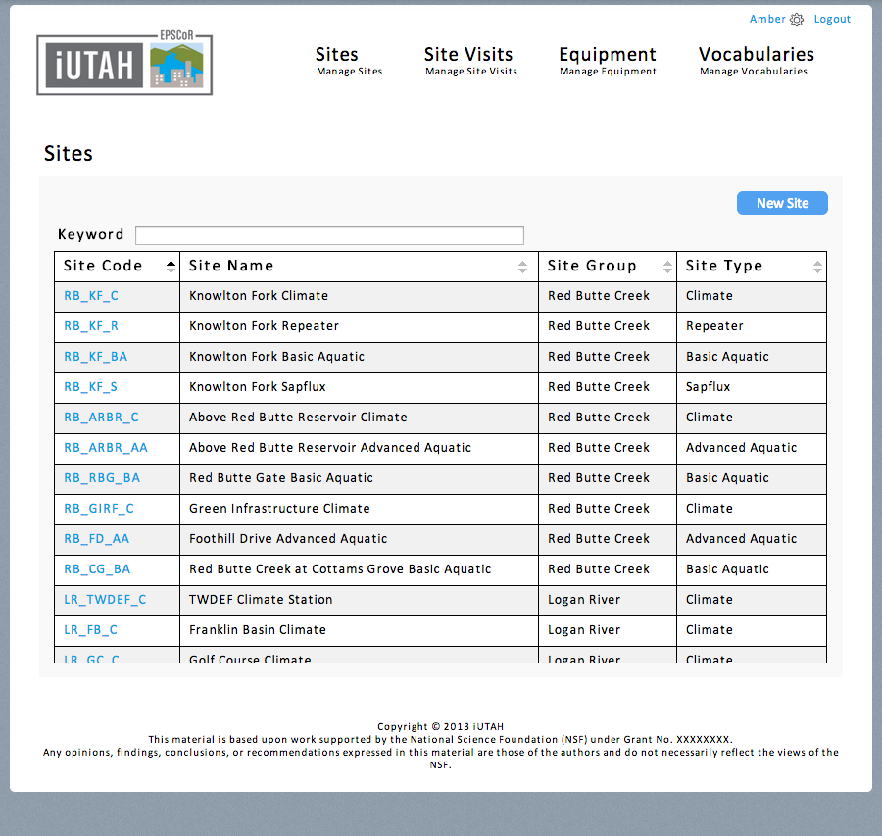
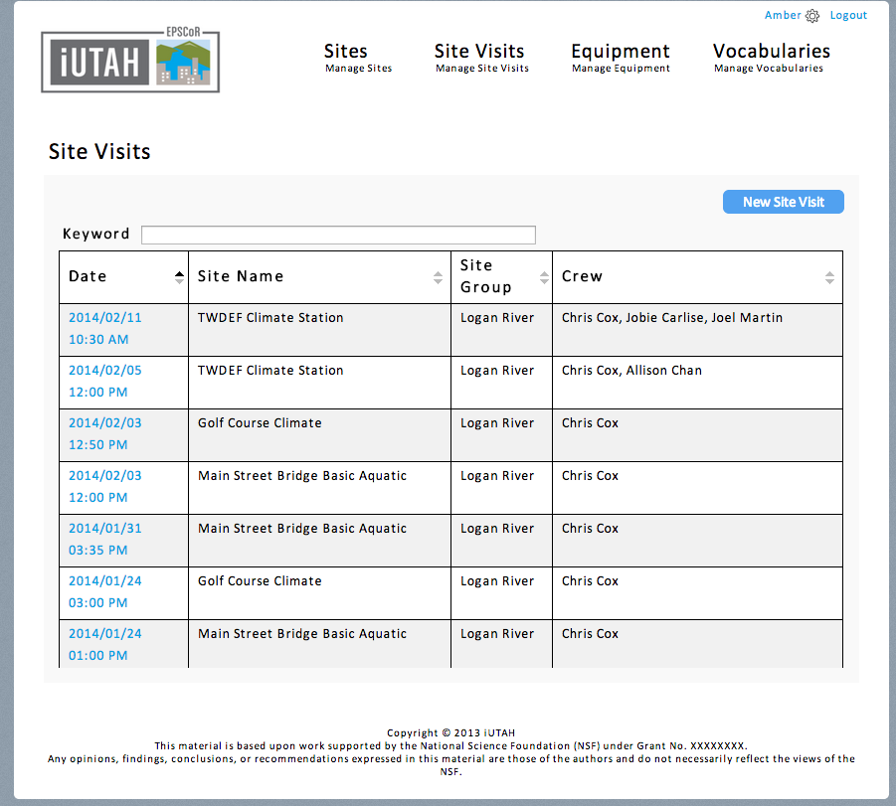
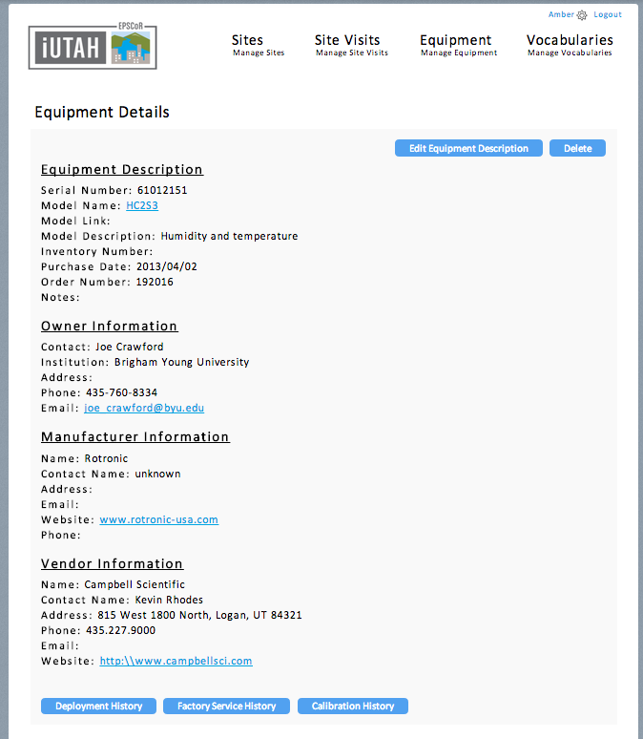
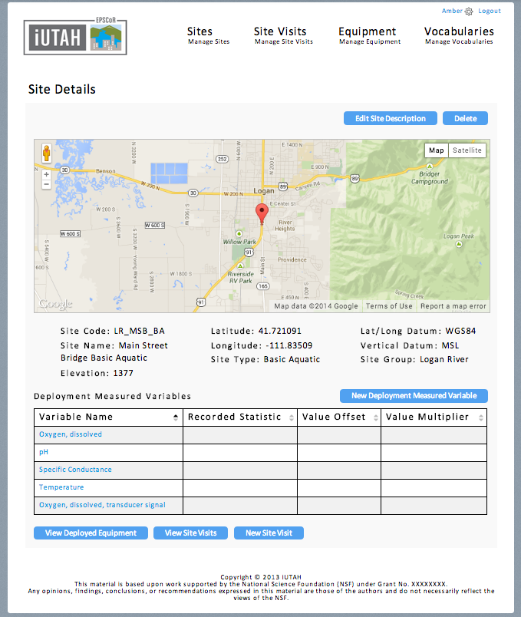
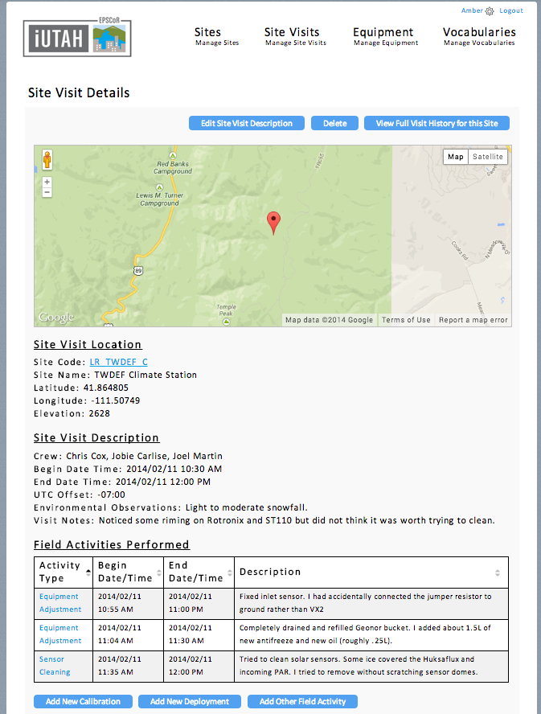
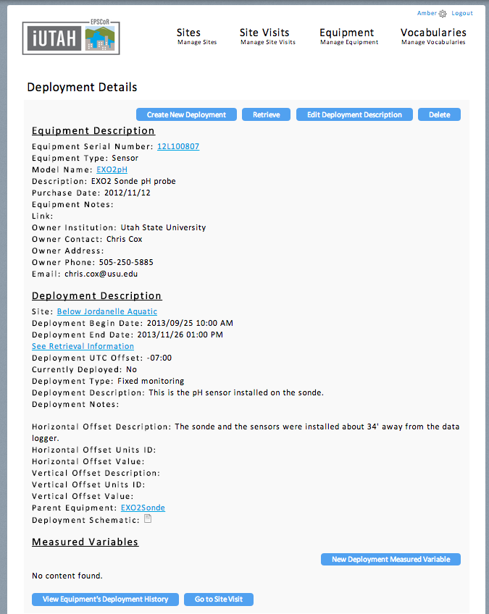
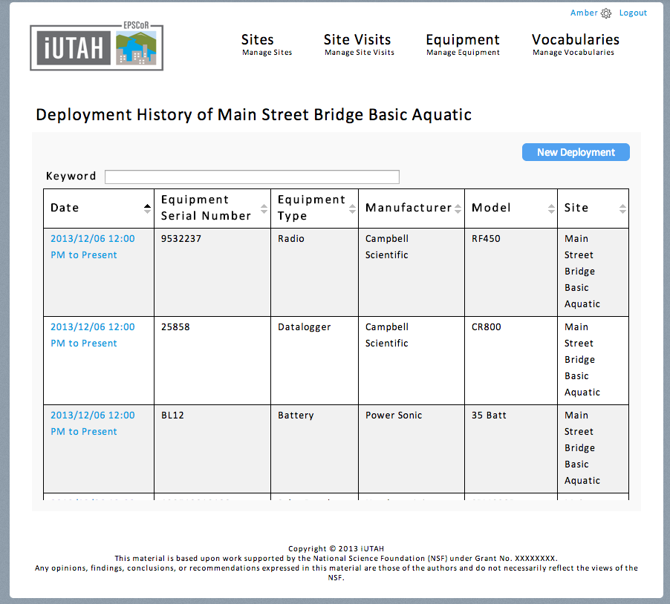
Monitoring Equipment Management
Record site information, site visits, and field activity details
Store information on physical equipment
Track equipment deployments, calibrations, service events

Slide 24
Requirement: Support Multiple Functional Use Cases

Slide 25
Legend
Database
Encoding
XML Schema
Encoding
Catalog
Metadata
Catalog
Data and Metadata Transfer
Metadata
Transfer
Metadata
Transfer
Metadata Harvesting
Data Discovery
Information Model
Data Storage
Data Server
Data Delivery
Clients
Data
Transfer

Slide 26
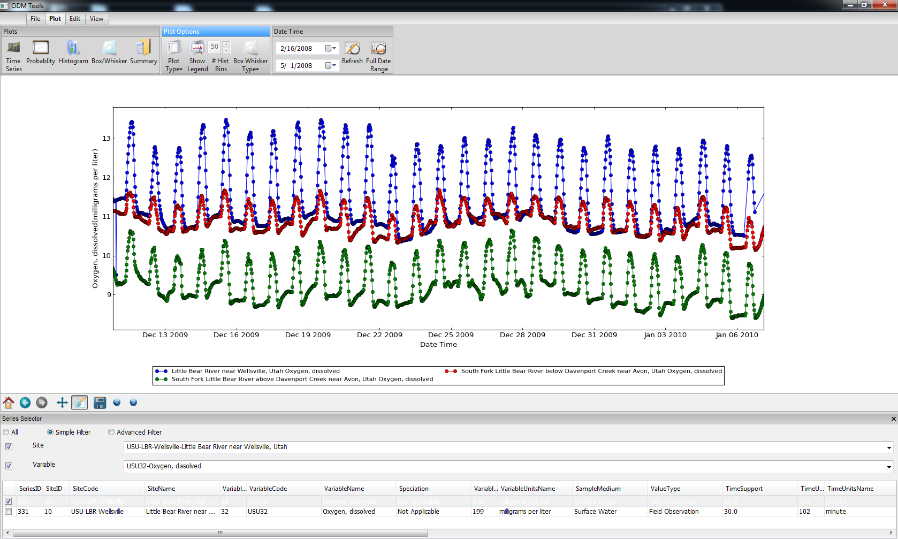





Storage Implementation
Multiple platform support
Storage implementation available for multiple Relational Database Management Systems (RDBMS)
Python-based software tools for multiple platforms
ODM2

Slide 27
Summary and Status
ODM2 is an information model for spatially discrete, feature-based earth observations
ODM2 supports sensor and sample based data – and many other result types
Integration of sensor and sample-based data in the Critical Zone Observatory Integrated Data Management System (CZOData)
Implementation of ODM2 in production systems at IEDA
Development of supporting software tools for more general use via BiG CZ SSI project
Storage of time series and sample-based data for HydroShare

Slide 28


ODM2 on
Questions?
Available now:
Storage implementations for Microsoft SQL Server, MySQL, PostgreSQL, SQLite
Documentation and use cases for information model
Python API for database interaction
Coming soon:
ODM2 data loader(s) and input templates
CUAHSI HIS WaterOneFlow web services
ODM Tools for QA/QC of sensor data
Web interface for recording field activities and sampling workflows
Support:
1224638
https://github.com/UCHIC/ODM2

